Slide 1
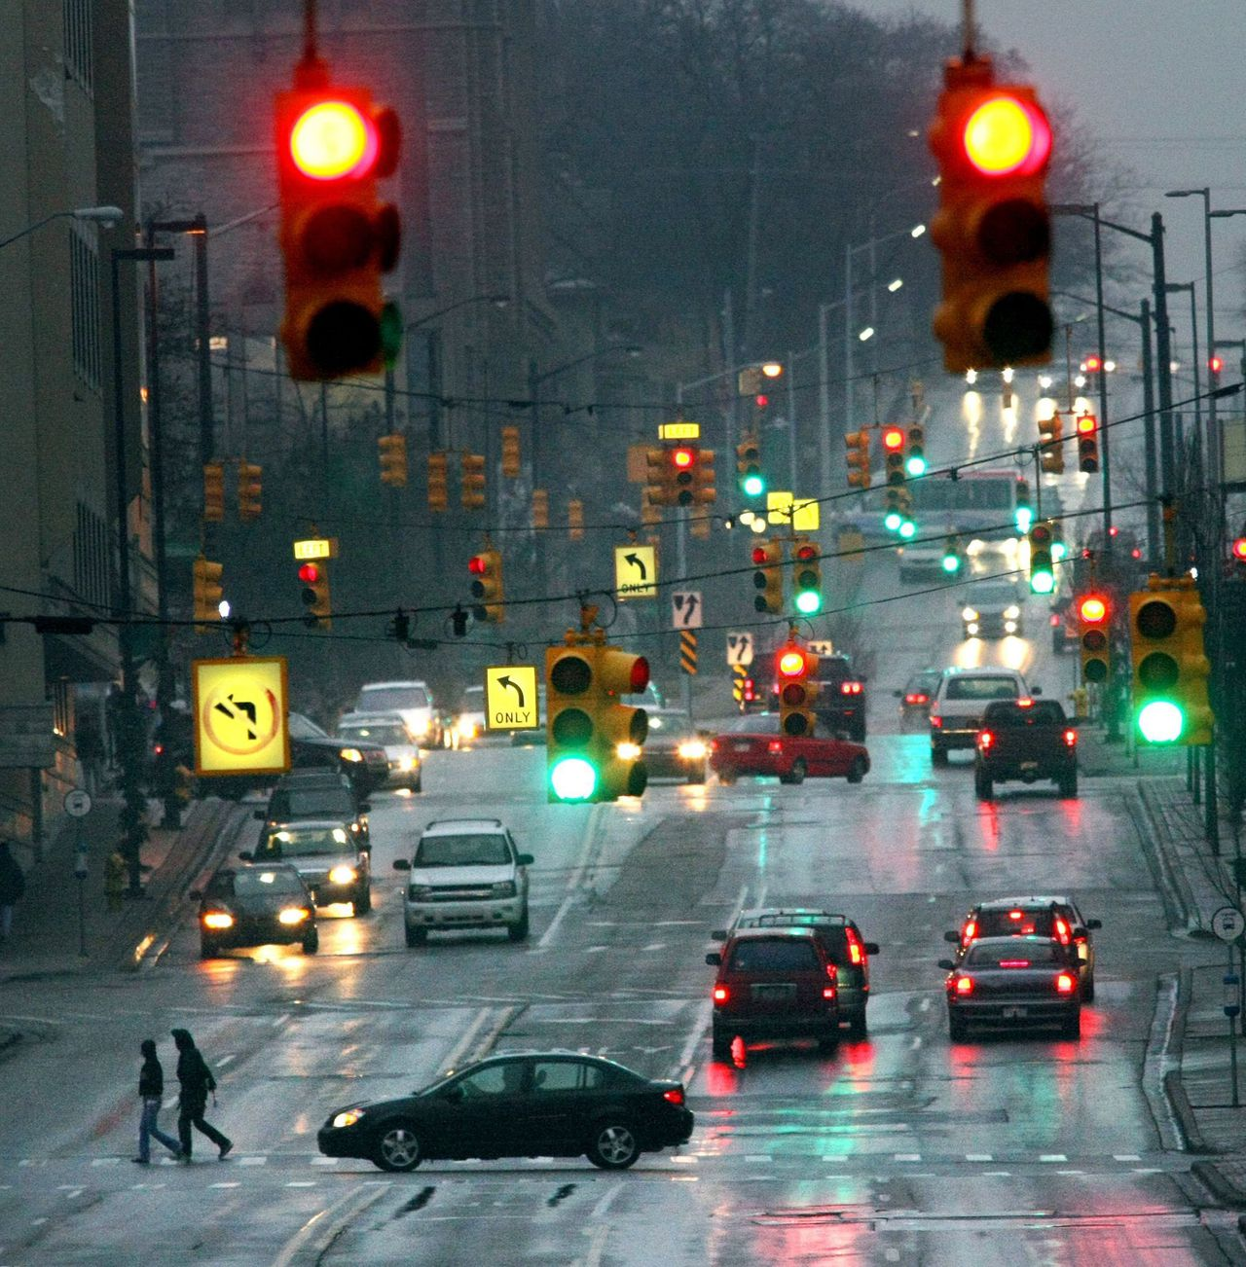

ABALEET Final Presentation
Beki Márta (2073056)
Luka Bijma
Alexey Zobnin
Basheva Elitsa
Elisé Minani
Aryan Shinde
Tim van Kollenburg

Slide 2
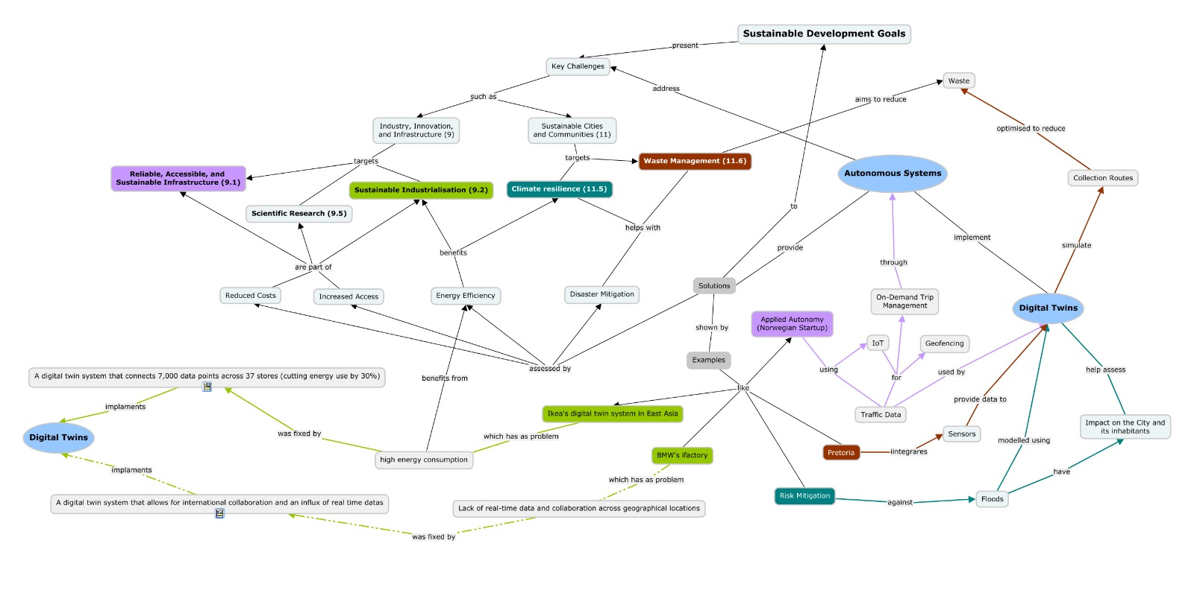
Initial concept
Notes:
Problems:
Too stuffy
Arrows pointing everywhere
Some places miss arrows
Too long nodes
Digital Twins mentioned twice
No clear starting point

Slide 3
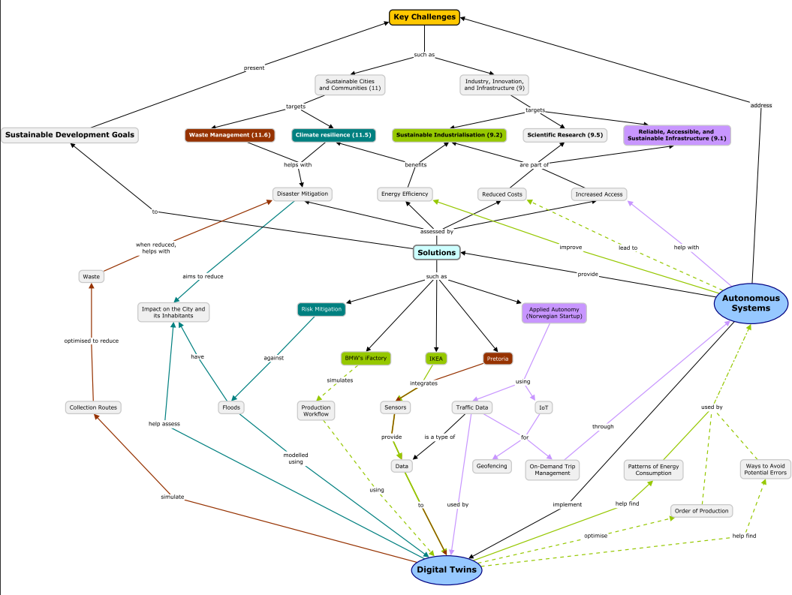
Initial concept
Clearer structure
Less long nodes
Better visual
Arrows
Colouring
Works towards technical solution

Slide 4
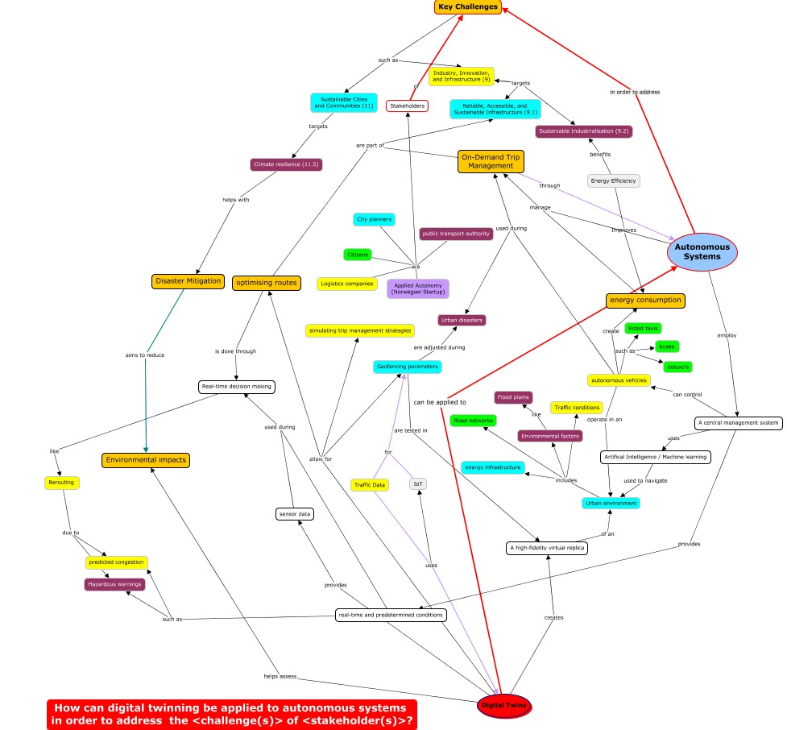
Technical Solution

